Slide 1
Objects & Classes

Slide 2
Class, methods and Object
Class classname:
def __init__(self):
self.val1 := define
self.val2:= define
def display():
print(val1,val2) #define method
ob1=classname(val1,val2)
print(ob1)

Slide 3
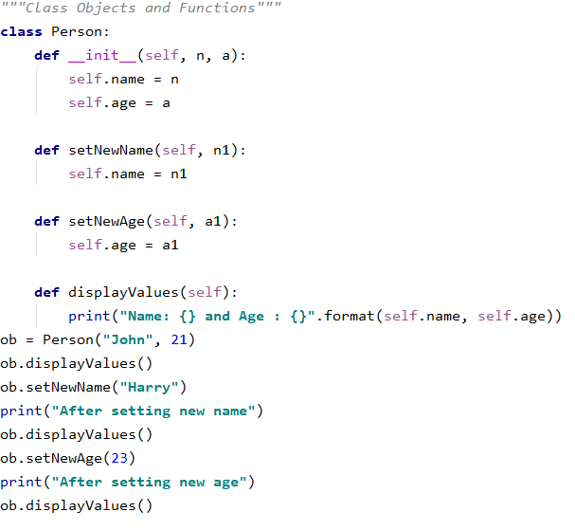
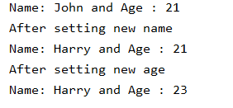
Example
Result:

Slide 4
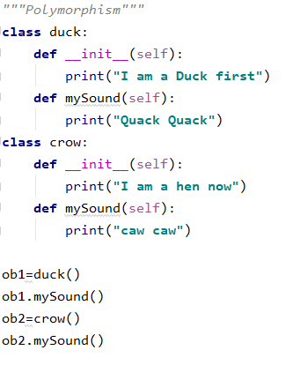
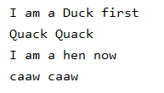
Polymorphism
Result

Slide 5
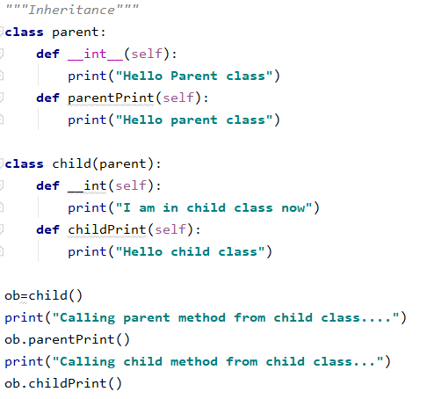
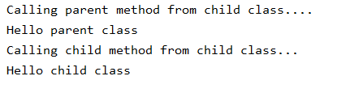
Inheritance
Result:

